Slide 1


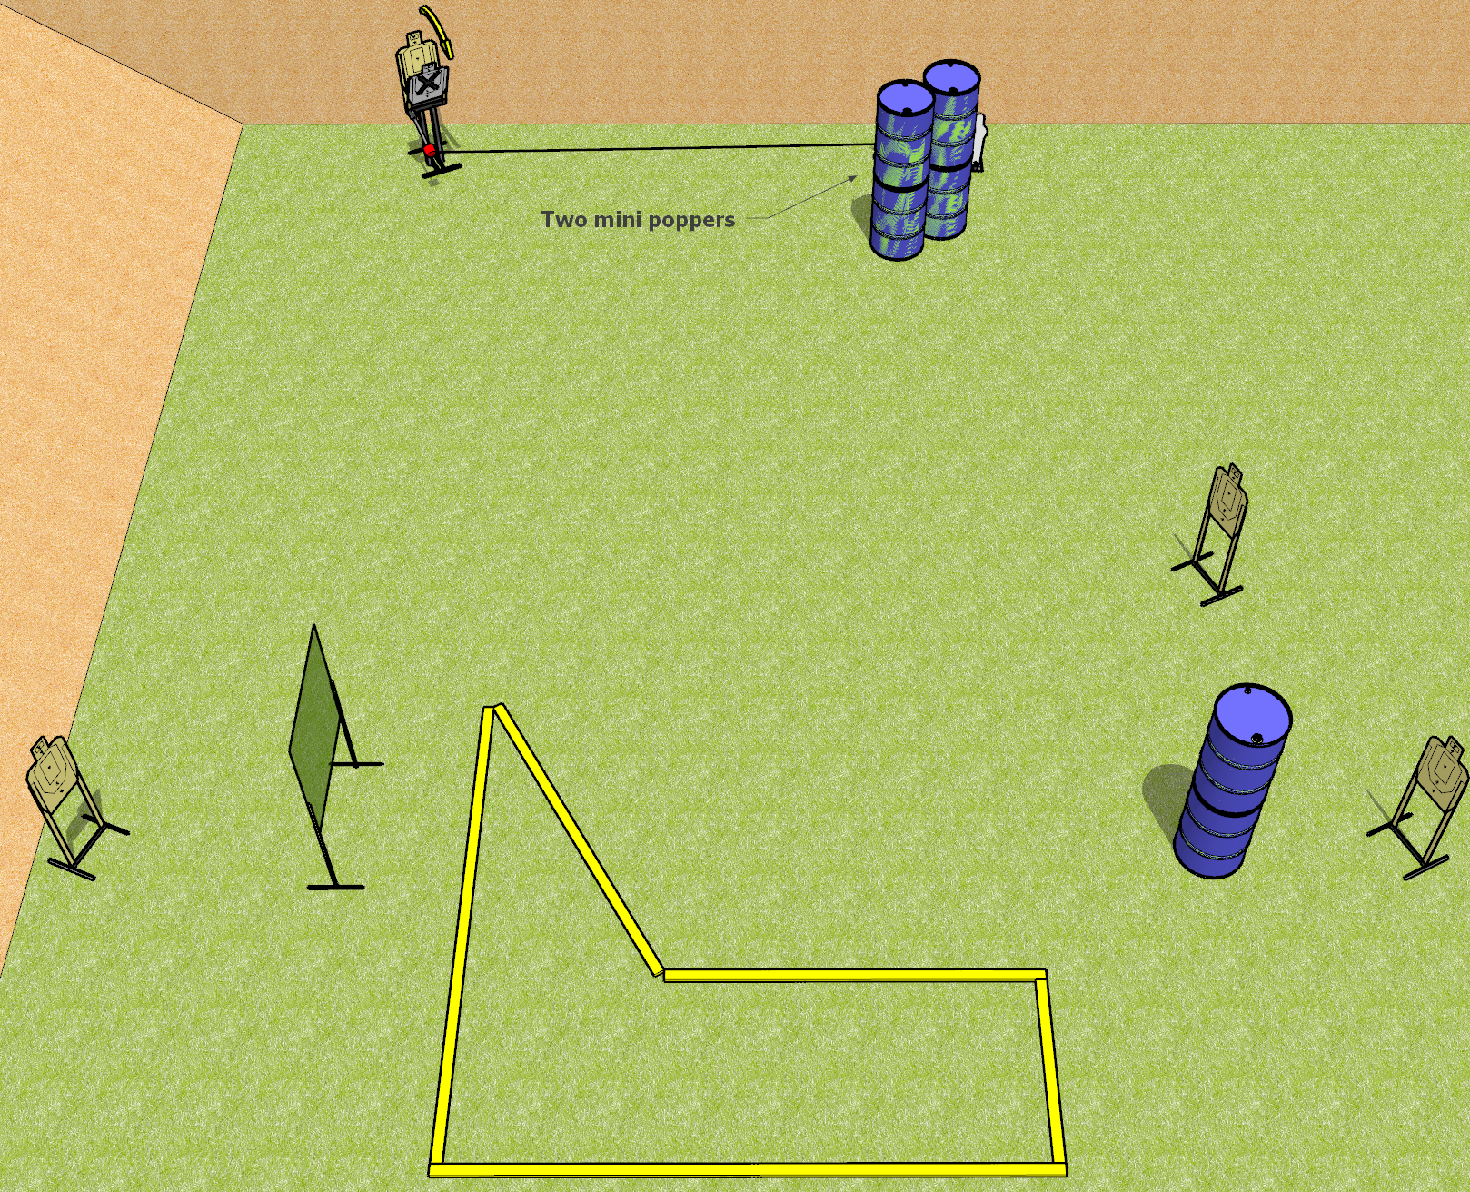
 | Dothan Gun Club – USPSA Match It Goes to 11 Course Designer : Drew Coleman
START POSITION : Straddling any fault line, one foot inside the shooting area other foot outside the shooting area not touching any fault line, wrists below belt
GUN READY CONDITION : Pistol loaded and holstered. PCC loaded, held with both hands, stock on belt, safety on. |  | SCORING: Comstock, 11 rounds TARGETS: 4 paper, 3 Steel SCORED HITS: Best 2 on paper, steel until down START-STOP: Audible, last shot RULES:
STAGE PROCEDURE: Engage targets as they become available from within the fault lines.

Slide 2
It Goes to 11
Written Stage Briefing
It Goes to 11 is an 11 round, 55 point, Comstock short course. There are four USPSA targets and three mini poppers. The best two hits on paper will score, and steel must fall to score. The start signal is audible.
The rightmost popper activates the max trap. The max trap must be activated before being engaged. Please check the activator prior to walk through and set it the same way every time for each shooter.
Handgun start position is straddling any fault line, one foot inside and the other foot completely outside not touching any fault line. Wrists below belt. Handgun is loaded and holstered.
PCC start position is straddling any fault line, one foot inside and the other foot completely outside not touching any fault line. Loaded carbine is held with both hands, safety on, stock on belt.
On start signal, engage targets as they become available from within the shooting area.

Slide 3
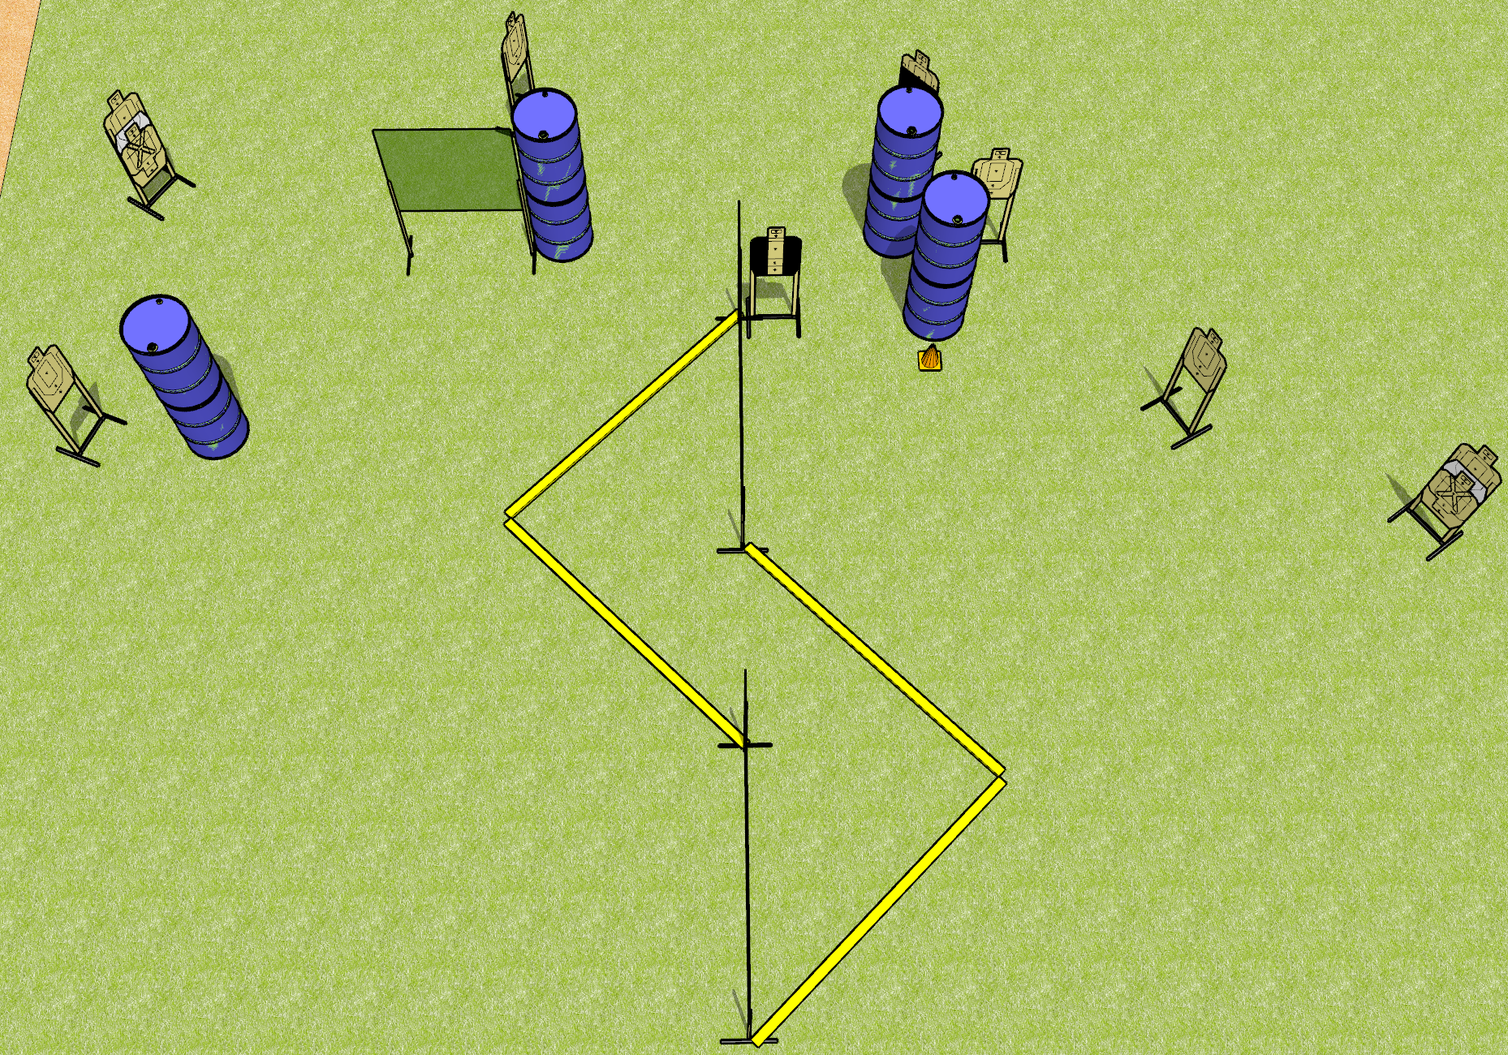
 | Dothan Gun Club – USPSA Match Ssssssssss Course Designer : Drew Coleman
START POSITION : Anywhere outside the shooting area, wrists below belt
GUN READY CONDITION : Pistol loaded and holstered. PCC loaded, held with both hands, shouldered, safety on, pointed at orange cone. |  | SCORING: Comstock, 20 rounds TARGETS: 10 paper, 0 Steel SCORED HITS: Best 2 on paper, steel until down START-STOP: Audible, last shot RULES:
STAGE PROCEDURE: Engage targets as they become available from within the fault lines.

Slide 4
Ssssssssss
Written Stage Briefing
Ssssssssss is a 20 round, 100 point, Comstock medium course. There are ten USPSA targets. The best two hits on paper will score. The start signal is audible.
Handgun start position is anywhere outside the shooting area, wrists below belt. Handgun is loaded and holstered.
PCC start position is anywhere outside the shooting area, muzzle pointed at orange cone. Loaded carbine is held with both hands, safety on, shouldered.
On start signal, engage targets as they become available from within the shooting area.

Slide 5
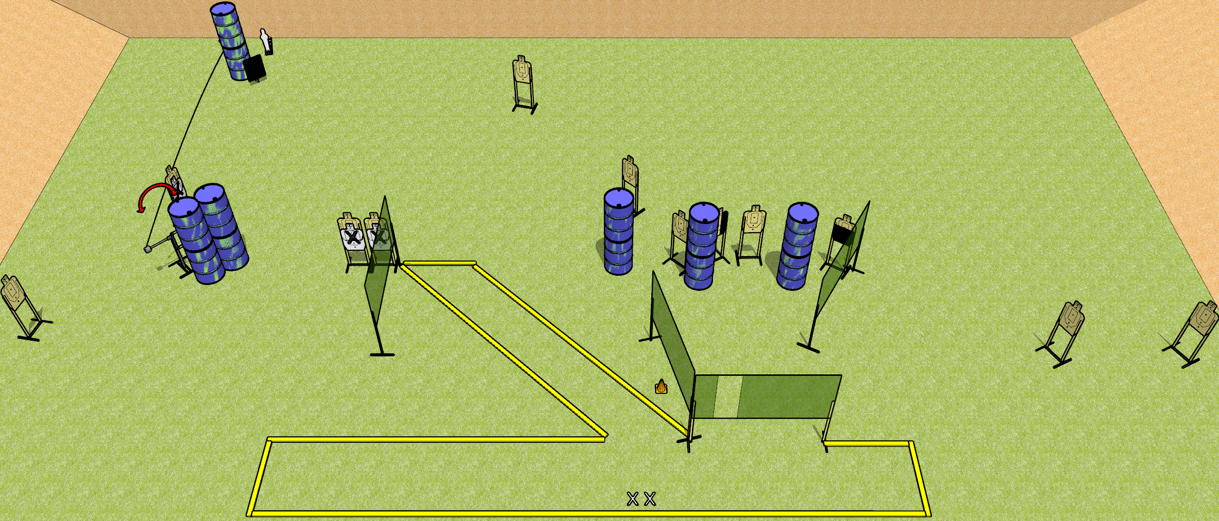
 | Dothan Gun Club – USPSA Match Spiky Course Designer : Drew Coleman
START POSITION : Both feet on X’s, wrists below belt
GUN READY CONDITION : Pistol loaded and holstered. PCC loaded, held with both hands, shouldered, safety on, pointed at orange cone. |  | SCORING: Comstock, 28 rounds TARGETS: 13 paper, 2 Steel SCORED HITS: Best 2 on paper, steel until down START-STOP: Audible, last shot RULES: Swinger must be activated before being engaged
STAGE PROCEDURE: Engage targets as they become available from within the fault lines.

Slide 6
Spiky
Written Stage Briefing
Spiky is a 28 round, 140 point, Comstock field course. There are thirteen USPSA targets and two mini poppers. The best two hits on paper will score, and steel must fall to score. The start signal is audible.
The left mini popper will activate the swinger. Please check the activator prior to walkthrough and set it up the same way every time. The swinger must be activated before being engaged.
Handgun start position is both feet on X’s, wrists below belt. Handgun is loaded and holstered.
PCC start position is both feet on X’s, muzzle pointed at orange cone. Loaded carbine is held with both hands, safety on, shouldered.
On start signal, engage targets as they become available from within the shooting area.

Slide 7
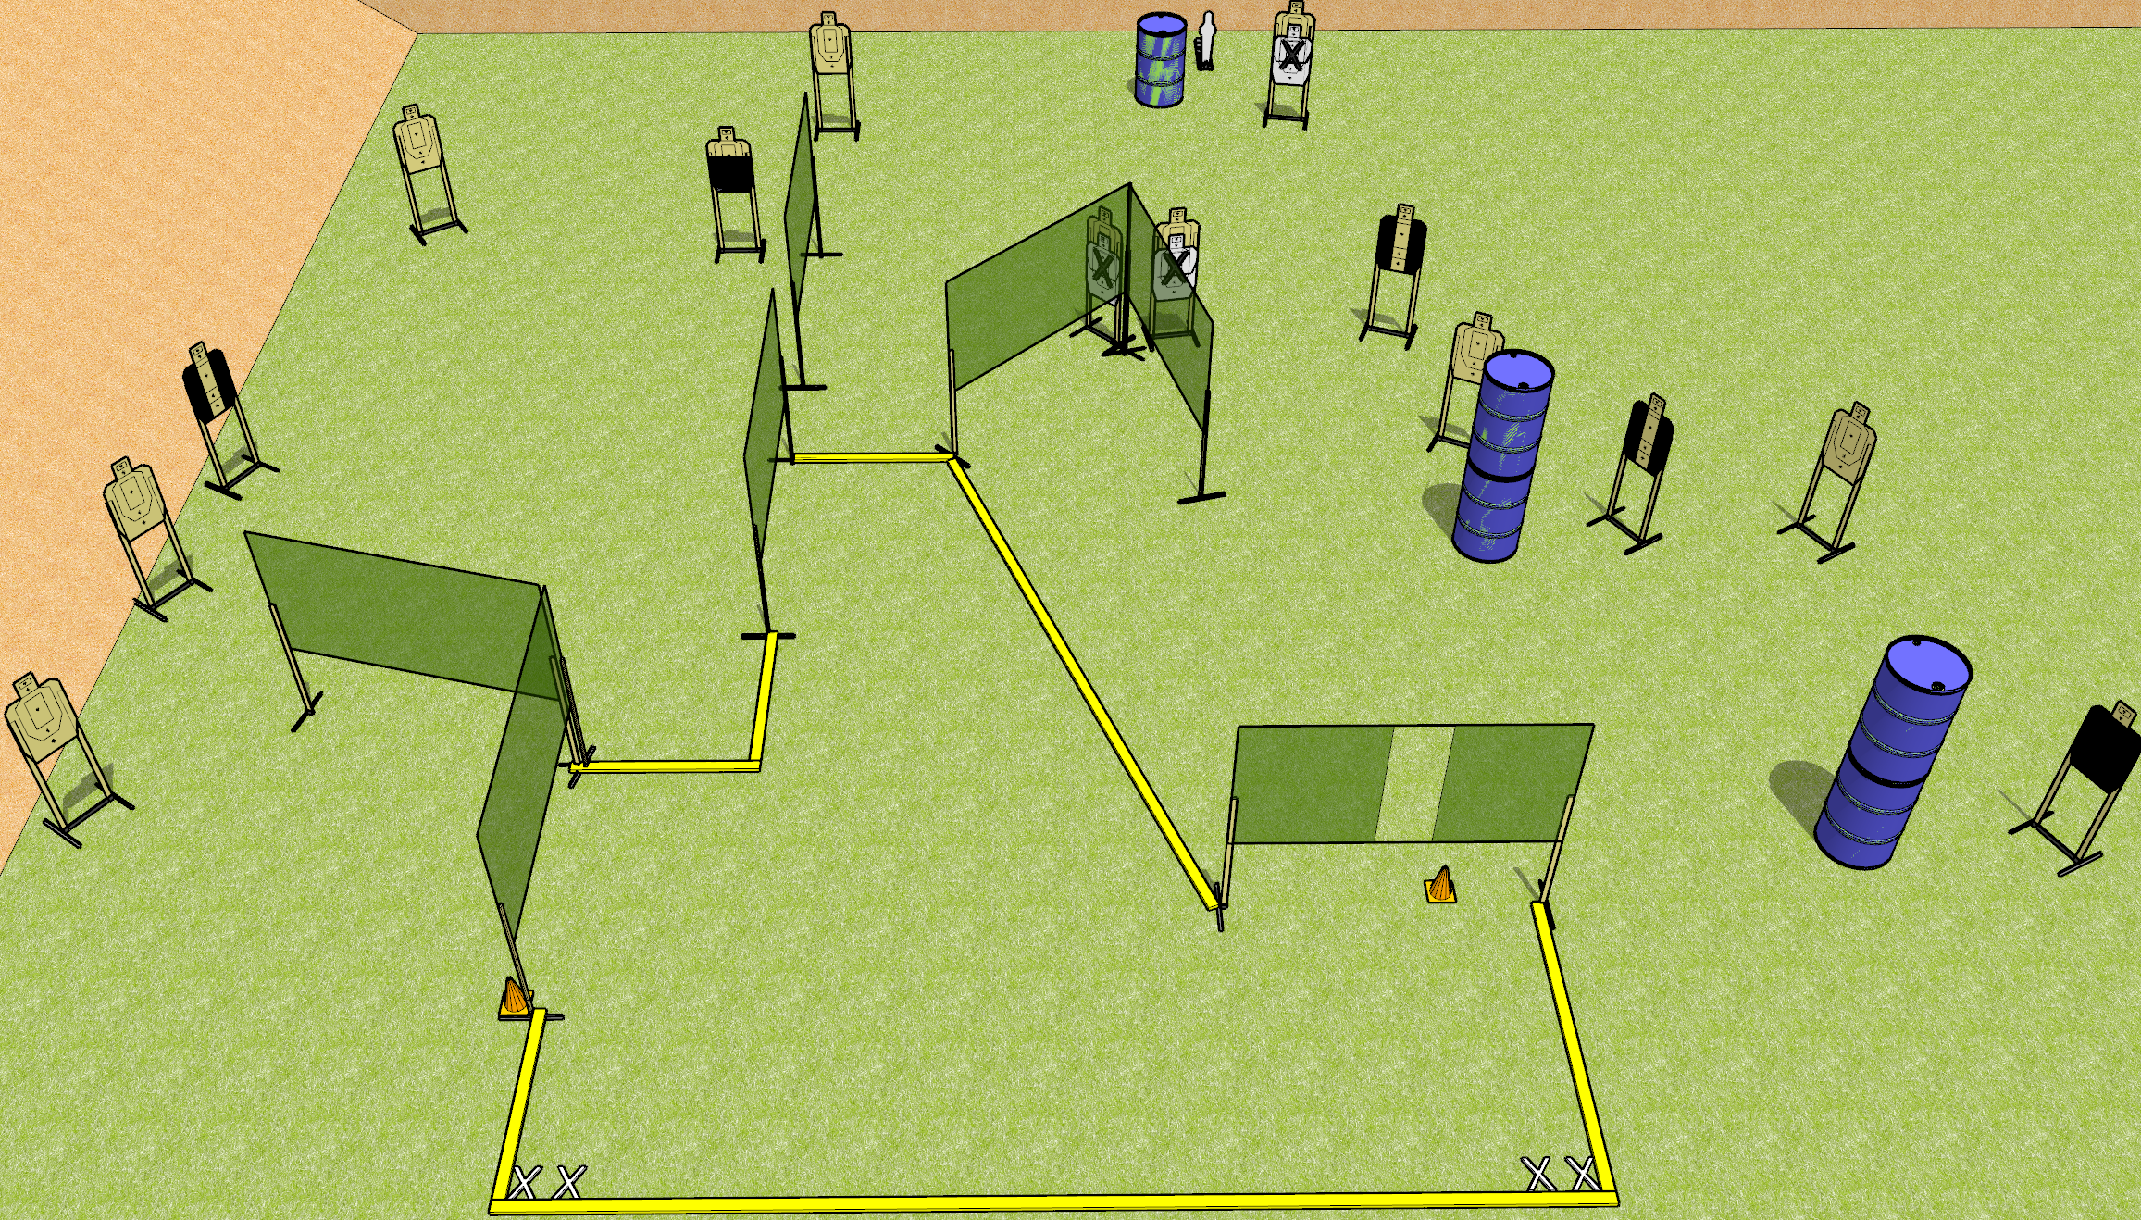
 | Dothan Gun Club – USPSA Match Shooty McShoot Face Course Designer : Drew Coleman
START POSITION : Both feet on either set of X’s, wrists above shoulders
GUN READY CONDITION : Pistol loaded and holstered. PCC loaded, held with both hands, shouldered, safety on, pointed at either orange cone. |  | SCORING: Comstock, 29 rounds TARGETS: 14 paper, 1 Steel SCORED HITS: Best 2 on paper, steel until down START-STOP: Audible, last shot RULES:
STAGE PROCEDURE: Engage targets as they become available from within the fault lines.

Slide 8
Shooty McShoot Face
Written Stage Briefing
Shooty McShoot Face is a 28 round, 140 point, Comstock field course. There are fourteen USPSA targets and one mini popper. The best two hits on paper will score, and steel must fall to score. The start signal is audible.
Handgun start position is both feet on either set of X’s, wrists above shoulders. Handgun is loaded and holstered.
PCC start position is both feet on either set of X’s, muzzle pointed at either orange cone. Loaded carbine is held with both hands, safety on, shouldered.
On start signal, engage targets from within the shooting area.

Slide 9
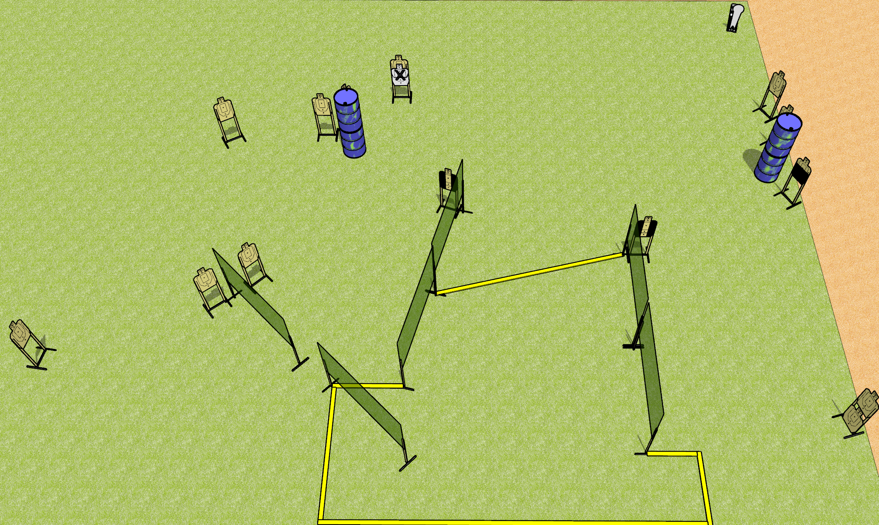
 | Dothan Gun Club – USPSA Match Angled Course Designer : Drew Coleman
START POSITION : Inside shooting area, heels against rear fault line, wrists below belt
GUN READY CONDITION : Pistol unloaded and holstered. PCC unloaded, held with both hands, stock on belt. |  | SCORING: Comstock, 29 rounds TARGETS: 14 paper, 1 Steel SCORED HITS: Best 2 on paper, steel until down START-STOP: Audible, last shot RULES:
STAGE PROCEDURE: Engage targets as they become available from within the fault lines.

Slide 10
Angled
Written Stage Briefing
Angled is a 29 round, 145 point, Comstock field course. There are fourteen USPSA targets and one Colt popper. The best two hits on paper will score and steel must fall to score. The start signal is audible.
Handgun start position is inside the shooting area, heels against rear fault line, wrists below belt. Handgun is unloaded and holstered.
PCC start position is inside the shooting area, heels against rear fault line. Unloaded carbine is held with both hands, stock on belt.
On start signal, engage targets as they become available from within the shooting area.

Slide 11
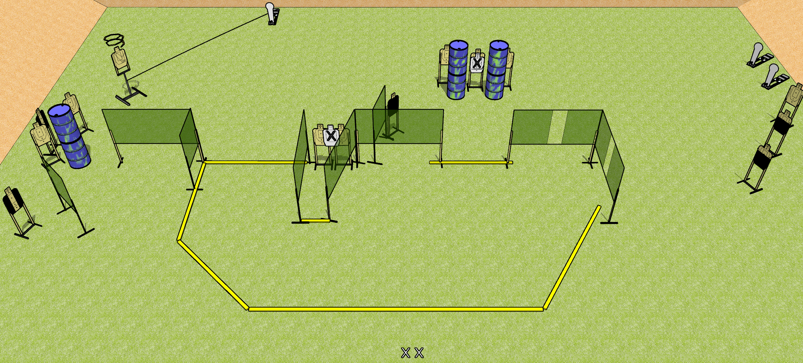
 | Dothan Gun Club – USPSA Match Scoot and Shoot Course Designer : Drew Coleman
START POSITION : Standing with both feet on X’s, wrists below belt
GUN READY CONDITION : Pistol loaded and holstered. PCC loaded, held with both hands, shouldered, safety on. |  | SCORING: Comstock, 31 rounds TARGETS: 14 paper, 3 Steel SCORED HITS: Best 2 on paper, steel until down START-STOP: Audible, last shot RULES: Drop turner is a disappearing target
STAGE PROCEDURE: Engage targets as they become available from within the fault lines.

Slide 12
Scoot and Shoot
Written Stage Briefing
Scoot and Shoot is a 31 round, 155 point, Comstock field course. There are fourteen USPSA targets and three Colt poppers. The best two hits on target will score, and steel must fall to score. The start signal is audible.
The drop turner is activated by the leftmost popper. It is a disappearing target. Please check the activator prior to walkthrough and set it the same way every time.
Handgun start position is both feet on X’s, wrists below belt. Handgun is loaded and holstered.
PCC start position is both feet on X’s. Loaded carbine is held with both hands, safety on.
On start signal, engage targets as they become available from within the shooting area.

Slide 13
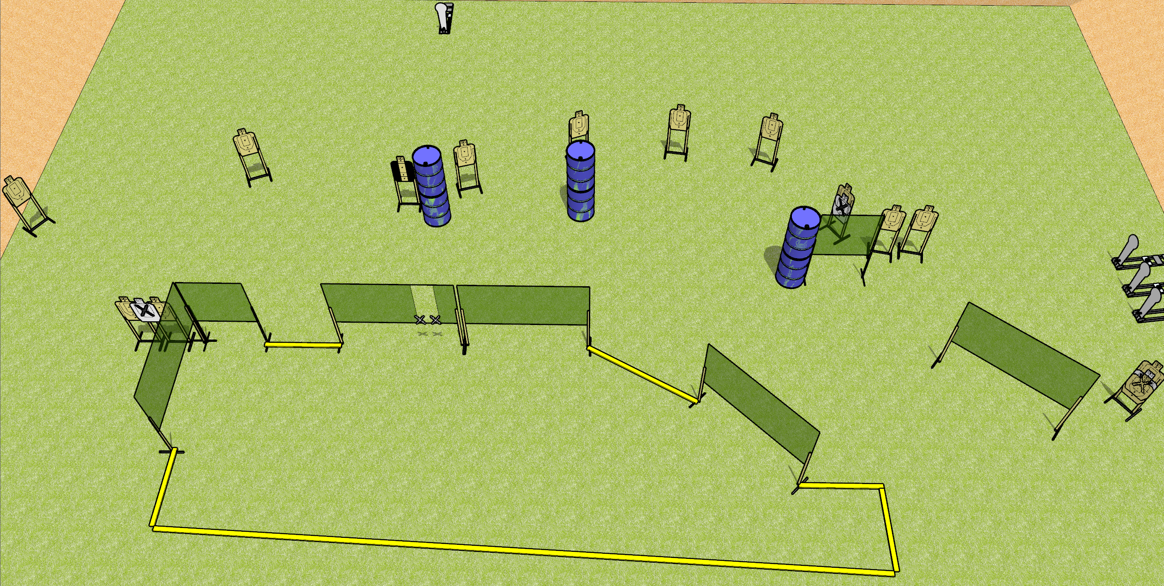
 | Dothan Gun Club – USPSA Match Spoiled Course Designer : Drew Coleman
START POSITION : At the port, palms touching the inside edges of the port. PCC muzzle touching inside edge.
GUN READY CONDITION : Pistol loaded and holstered. PCC loaded, held with both hands, shouldered, safety on, muzzle resting on inside edge. |  | SCORING: Comstock, 32 rounds TARGETS: 14 paper, 4 Steel SCORED HITS: Best 2 on paper, steel until down START-STOP: Audible, last shot RULES:
STAGE PROCEDURE: Engage targets as they become available from within the fault lines.

Slide 14
Spoiled
Written Stage Briefing
Spoiled is a 32 round, 160 point, Comstock field course. There are fourteen USPSA targets and four Colt poppers. The best two hits on paper will score, and steel must fall to score. The start signal is audible.
Handgun start position is near the port with palms of both hands touching the inside edge of the port. Handgun is loaded and holstered.
PCC start position is near the port with muzzle touching inside edge of port. Loaded carbine is held with both hands, shouldered, safety on.
On start signal, engage targets as they become available from within the shooting area.

